Slide 1
Mutation
Md Mazedul Haq

Slide 2
Human genome: individuals 99.9% identical
For every 1000 people . . .
Sequencing revealed one major allele for most genes in populations
Human populations have not been genetically isolated for very long (~2-3 M years)
Many variations have not had time to spread throughout populations.

Slide 3


Each Individual Should be Almost Same!!!
Not Actually

Slide 4
Human genome: individuals 0.1% different
For every person . . .
Lots of variation!
3.2 x 10⁹ bp/genome x 0.001 changes/bp =
3.2 x 10⁶ changes/genome
Two major types of variation
SNPs
Repeated DNA - short to long repeats
Variations produce RFLPs (Restriction Fragment Length Polymorphisms)!

Slide 5
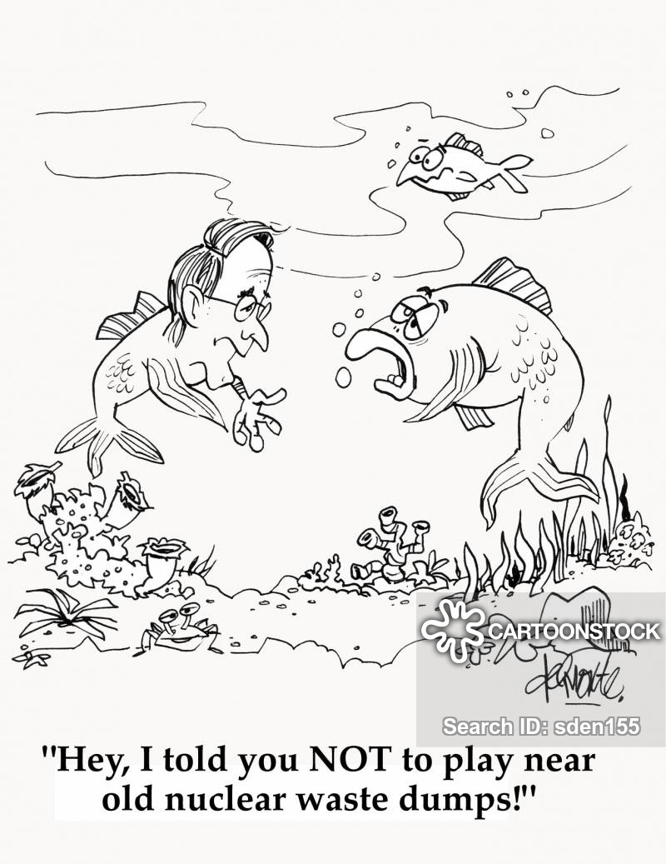
Mutation

Slide 6
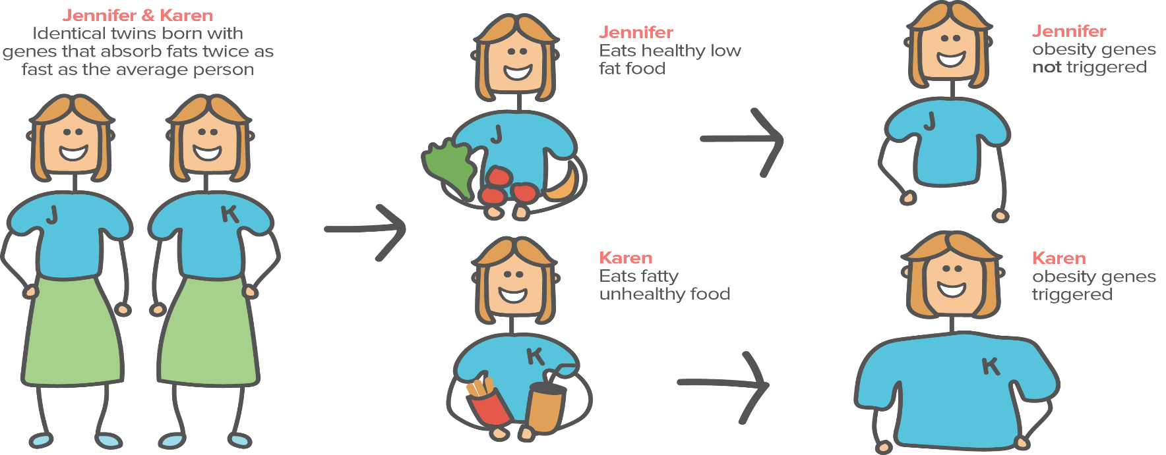
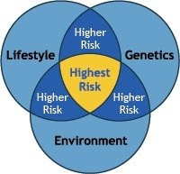
Diversity & Mutation

Slide 7

Introduction
Sudden heritable change in genetic material or character of an organism is
known as mutation
Individuals showing these changes are known as mutants
An individual showing an altered phenotype due to mutation are known as
variant
Factor or agents causing mutation are known as mutagens
Mutation which causes changes in base sequence of a gene are known as
gene mutation or point mutation

Slide 8


Classification of mutation
Based on the survival of an individual
Lethal mutation – when mutation causes death of all individuals undergoing mutation are known as lethal
Sub lethal mutation - causes death of 90% individuals
Sub vital mutation– such mutation kills less than 90% individuals
Vital mutation -when mutation don’t affect the survival of an individual are
known as vital
Supervital mutation – This kind of mutation enhances the survival of individual

Slide 9


Classification of mutation
Based on causes of mutation
Spontaneous mutation-
Spontaneous mutation occurs naturally without any cause. The rate of spontaneous mutation is very slow eg- Methylation followed by deamination of cytosine.
Rate of spontaneous mutation is higher in eukaryotes than prokaryotes.
Eg. UV light of sunlight causing mutation in bacteria
Induced Mutation-
Mutations produced due to treatment with either a chemical or physical
agent are called induced mutation .
The agents capable of inducing such mutations are known as mutagen.
use of induced mutation for crop improvement program is known as mutation breeding.
Eg. X- rays causing mutation in cereals

Slide 10


Classification of mutation
Based on tissue of origin
1. Somatic mutation-
A mutation occurring in somatic cell is called somatic mutation.
In asexually reproducing species somatic mutations transmits progeny to the next progeny
from one
2. Germinal Mutation-
When mutation occur in gametic cells or reproductive cells are known as germinal mutation.
In sexually reproductive species only germinal mutation are transmitted to the
next generation

Slide 11

Classification of mutation
Type of trait affected
1. | Visible mutation- | Those | mutation | which | affects on
 | phenotypic character | and | can be | detected | by normal
observation are known as visible mutation
2. Biochemical mutation- mutation which affect the production of biochemicals and which does not not show any phenotypic character are known as biochemical mutation

Slide 12
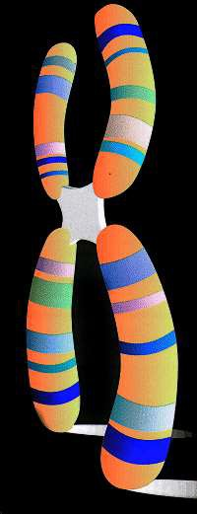
Chromosome Mutations
May Involve:
– Changing the structure
-loss or gain

Slide 13
Chromosome Mutations
Five types exist:
–Deletion
–Inversion
–Translocation
–Nondisjunction
–Duplication

Slide 14
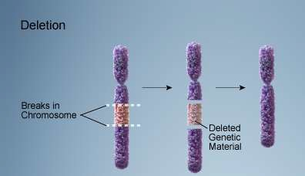
Deletion
Due to breakage
A piece of a chromosome is lost

Slide 15
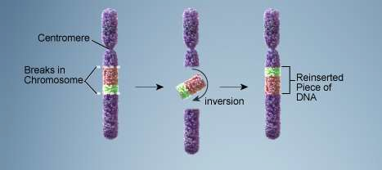
Inversion
Chromosome segment
breaks off
Segment flips around
backwards
Segment reattaches

Slide 16
Translocation
Involves two chromosomes that aren’t
homologous
Part of one chromosome is transferred to another chromosomes

Slide 17
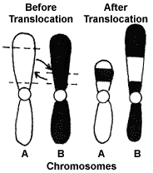
Translocation

Slide 18
Nondisjunction
Failure of chromosomes to separate during meiosis
Causes gamete to have too many
or too few chromosomes
Disorders:
Down Syndrome –
Turner Syndrome –
Klinefelter’s Syndrome –

Slide 19
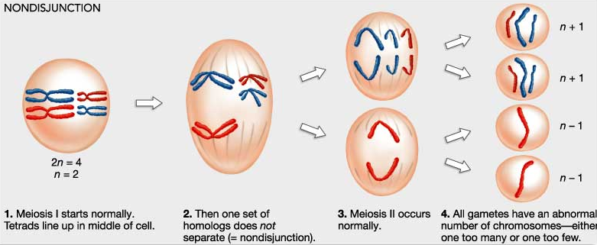
Nondisjunction

Slide 20
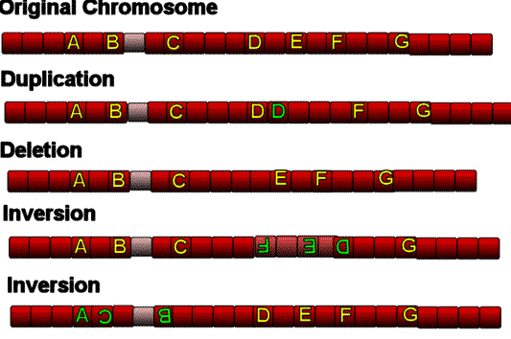
Chromosome Mutation

Slide 21
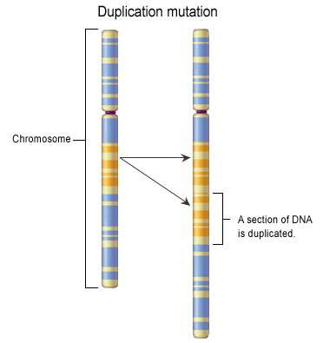
Duplication
Occurs when a gene sequence is repeated

Slide 22
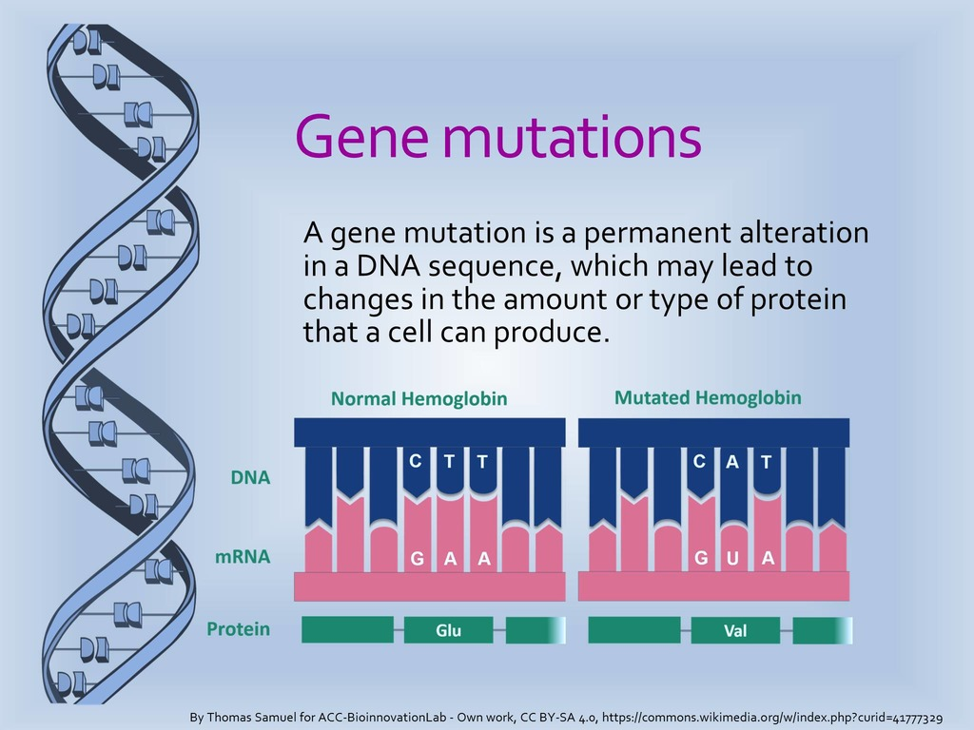

Slide 23
Types of Gene Mutations
Gene Mutation
Frameshift Mutation
Insertion
Deletion
Base Substitution
Point Mutation

Slide 24
Point Mutation
Change of a single nucleotide
Includes the deletion, insertion, or substitution of ONE nucleotide in a gene

Slide 25
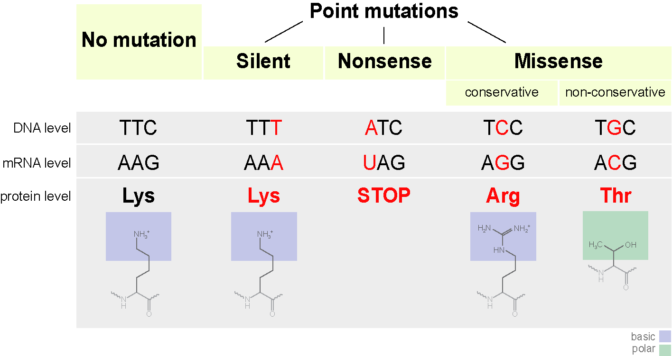
Point Mutation

Slide 26
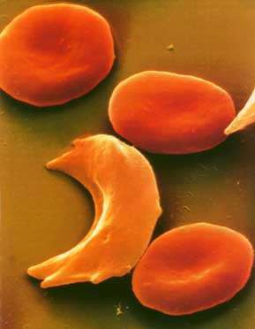
Point Mutation
Sickle Cell disease is the result of one nucleotide substitution
Occurs in the
hemoglobin gene

Slide 27
Frameshift Mutation
Inserting or deleting one or more nucleotides
Changes the “reading frame” like
changing a sentence
Proteins built incorrectly

Slide 28
Frameshift Mutation
Original:
The fat cat ate the wee rat.
Frame Shift (“a” added):
The fat caa tet hew eer at.

Slide 29
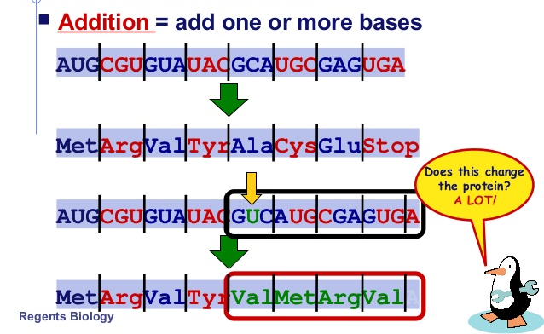
Frame Shift Mutation

Slide 30
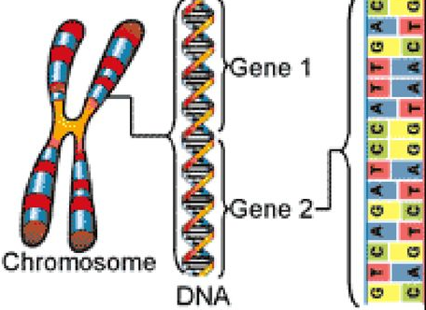
Which One is More Severe: Chromosome or Gene

Slide 31
Thank You

